Slide 1
Subsidized Childcare Assistance
By: Rasheeda Taylor La’Quanza Little

Slide 2
Agenda
What is SCCA
How to apply
Requirements
Waiting List & Vulnerable Populations
Income Limits
Resources
Q&A

Slide 3
What is SCCA?
The childcare subsidy program is a government assistance program that uses federal and state funding to provide eligible families with subsidized childcare services.

Slide 4
How to Apply for Daycare Assistance:
Phone
In-Person
Mail, Faxed or Email
This Photo by Unknown Author is licensed under CC BY-SA

Slide 5
Requirements (Chapter 4)
Subsidized childcare services may be provided to families demonstrating a need for childcare and who have been determined eligible for services. The eligibility requirements below must be discussed with the applicant during the initial interview and all requirements met to authorize childcare services.
Residency
Citizenship
Age of child
Reason childcare is needed
Income

Slide 6
Waiting List (Chapter 10)
Waiting lists provide an equitable and efficient method of allocating services when Local Purchasing Agencies (LPA) are faced with limited resources. Waiting lists must be developed when childcare funding is not available, childcare providers are not available, or the LPA lacks sufficient staff to process all requests for childcare services.

Slide 7
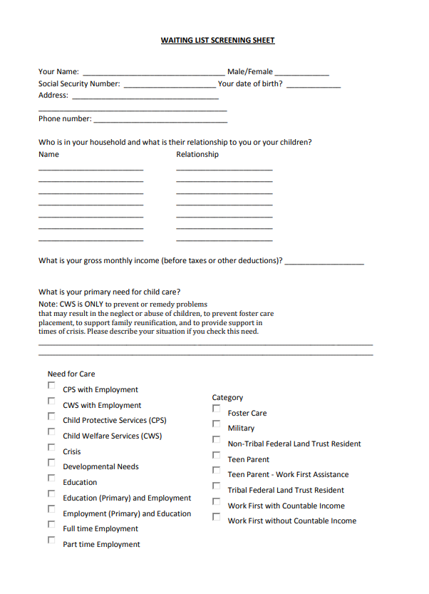
Screening Form:
Used to screen client to see if they are eligible to be placed on the waiting list.
The client must complete the form and provide two of their most recent paycheck stubs and or their proof of post-secondary education.

Slide 8
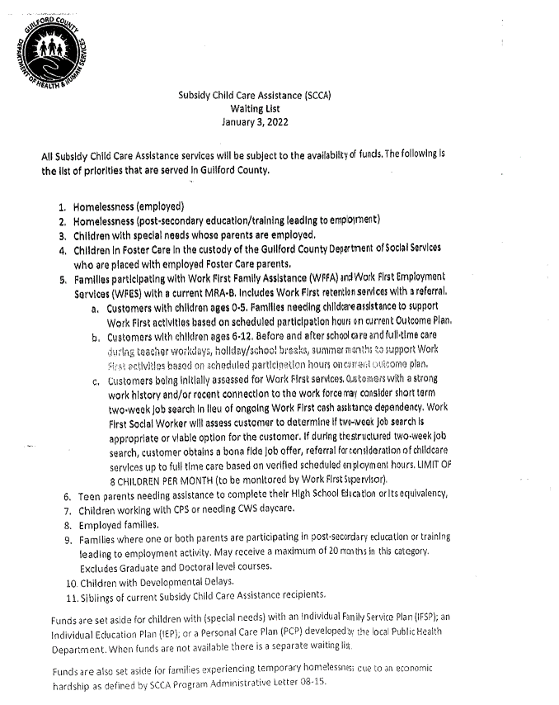
Waiting List: Priority Serving
As top priority, clients who are experiencing homelessness and are employed and or taking on a post-secondary education/ training leading to employment will be serviced immediately.

Slide 9
SCCA Admin Letter #08-17
Effective immediately as of October 3rd, 2017, the homeless population was prioritized on the serving list for the SCCA Program. The Child Care & Development fund were to set aside 4% of childcare subsidy resources to service vulnerable populations such as children having special needs or children and families experiencing homelessness.
This was sought out to help minimize poverty within the community, allowing these families to continue gainful employment/ education while experiencing hardship through the help of childcare assistance.

Slide 12
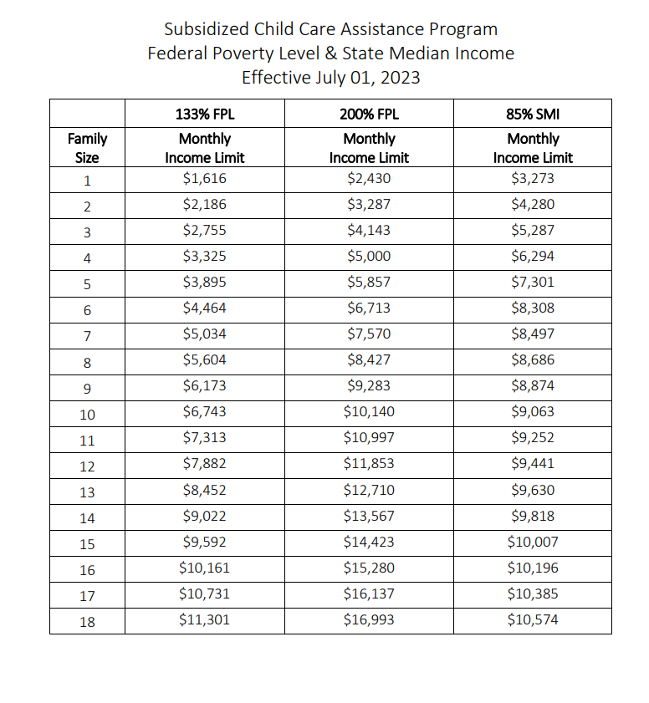
Income Limits (Chapter 7) Federal Poverty Level & State Median Income

Slide 13
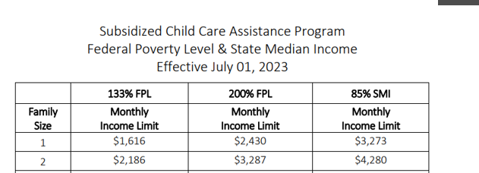
Income Limit Differences (Chapter 7)
The 133% FPL and 200% FPL are used at initial application when determining income eligibility.
133% FPL- families being serviced with children ages 6-12.
200% FPL- families being serviced with children ages 0-5 and for special needs children ages 0-17.
85% SMI- used for all ages when a family experiences increased income while already receiving SCCA
NOTE: If during a family's certification period, the income increases above the 85% SMI for the family size, the family is no longer income eligible.

Slide 14
Resources
NCHHS Child Daycare
Childcare Subsidy Info
Childcare Provider Search
Childcare Application English
Childcare Application Spanish

Slide 15
Questions

Slide 16
Thank You!
If you have any additional questions, please contact Brittany Gadsden at bgadsden@guilfordcountync.gov

