Slide 1
McKinney-Vento Act Students in Transition Overview
Drennan Paylor – Coordinator of Homeless Services and Community Support
Guilford County Continuum of Care Training
Whitney Oakley, ED.D. | SUPERINTENDENT

Slide 2
Mission
Guilford county students will graduate as responsible citizens prepared to succeed in higher education, or in the career of their choice.*
*This mission was adopted by the Guilford County Board of Education on December 12, 2000.
Vision
Transforming learning and life outcomes for all children

Slide 4
By the end of this session participants will be able to…
Explain the criteria for a student to be considered a homeless child or youth (HCY) under the McKinney-Vento Homeless Assistance Act (MV)
Identify the basic rights of students experiencing homelessness and LEA responsibilities for ensuring those rights

Slide 5
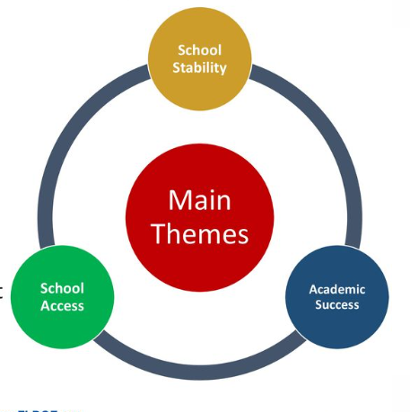
McKinney-Vento Homeless Assistance Act
Protects the educational rights of children and youth experiencing homelessness
Federal law
First enacted in 1987
Reauthorized in 2015 as Title IX of the Every Student Succeeds Act (ESSA)
The general purpose did not change from No Child Left Behind (NCLB)

Slide 6
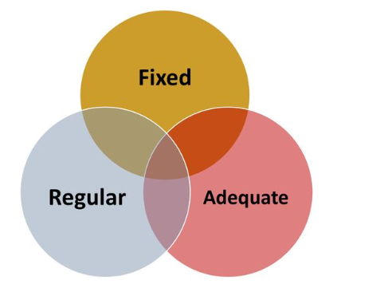
McKinney-Vento Definition of Homeless
Those who lack a fixed, regular and adequate nighttime residence, including students:
Sharing housing due to loss of housing, economic hardship, or a similar reason
Living in motels, hotels, trailer parks, camping grounds due to a lack of alternative, adequate accommodation
Living in emergency & transitional shelters
Abandoned in hospitals
Living in public or private places not designed for or ordinarily used as regular sleeping accommodations for human beings
Living in cars, parks, public spaces, abandoned buildings, bus or train stations or similar situations
Migratory children living in the above situations
42 U.S.C. § 11434a(2)

Slide 7
McKinney-Vento Definition of Homeless
Fixed, regular, and adequate are defined as:
A fixed residence is one that is stationary,
permanent, and not subject to change
A regular residence is one that is used on a
normal, standard, and consistent basis
An adequate residence is one that is sufficient for meeting both the physical and psychological needs typically met in home environments

Slide 8
Unaccompanied Homeless Youth
The term unaccompanied youth includes a homeless child or youth not in the physical custody of a parent or guardian.
42 U.S.C. § 11434a(6)
Have the same right to immediate enrollment & educational services as other students
Notes:
Flowchart for determining if a student is an UHY: https://nche.ed.gov/wp-content/uploads/2018/10/app-9a.doc
Indiana has some great third-party custodial forms: https://www.doe.in.gov/legal/forms

Slide 9
Unaccompanied Homeless Youth
There are no age limits in the McKinney-Vento Act
Eligibility is based on the student’s housing
Pathways to homelessness for unaccompanied youth:
35% of youth experienced the death of at least one parent or caregiver
44% of youth had been in foster care
24% were homeless with their families before becoming unaccompanied
https://www.chapinhall.org/wp-content/uploads/ChapinHall_VoYC_Youth-Pathways-FINAL.pdf
Notes:
Chapin Hall Missed Opportunities in Youth Pathways Through Homelessness, June 2019
Interviewed 215 youth aged 13-25 in five US Counties

Slide 10
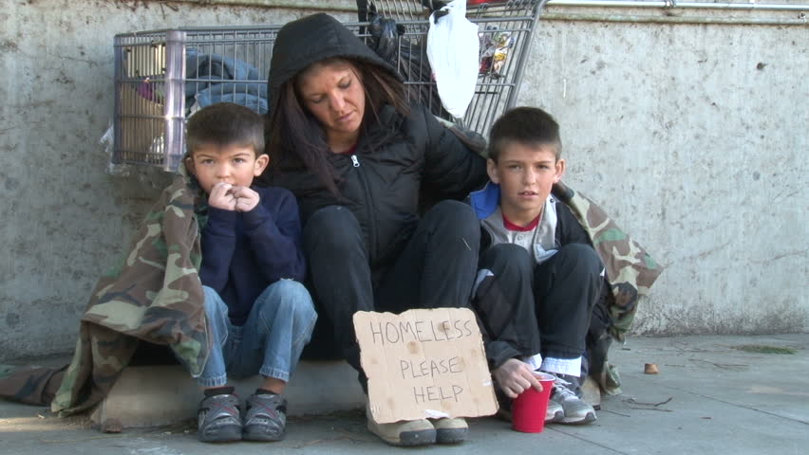
Additional Consequences of Being Homeless
Homeless students and their families typically experience:
Poor nutrition
Inadequate health care
Higher exposure to violence and emotional stress
Increased incidents of health impairments
Leaving behind a familiar space, their possessions, and people
Leaving behind projects half finished, cling to possessions, are restless, may exhibit aggressive behavior, or feel a loss of control as they fight for control at school
Notes:
Chapin Hall Missed Opportunities in Youth Pathways Through Homelessness, June 2019
Interviewed 215 youth aged 13-25 in five US Counties

Slide 11
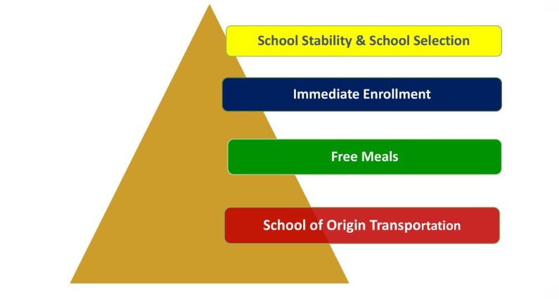
What Rights Does McKinney-Vento Provide?
Notes:
Chapin Hall Missed Opportunities in Youth Pathways Through Homelessness, June 2019
Interviewed 215 youth aged 13-25 in five US Counties

Slide 12
Mobility
Homeless students can lose four to six months of academic progress with one school move during a year.
Mobility also hurts non-mobile students; a study found average tests scores for non-mobile students were significantly lower in high schools with high student mobility rates
Students who change high schools even once during high school are less than half as likely as stable students to graduate, even accounting for other factors
Notes:
Chapin Hall Missed Opportunities in Youth Pathways Through Homelessness, June 2019
Interviewed 215 youth aged 13-25 in five US Counties

Slide 13
School Stability - Best Interest of Child
School of origin is presumed to be in student’s best interest
Unless this is contrary to parent or UHY’s wishes
Consider student-centered factors
Impact of mobility on achievement, education, health, & safety 42 U.S.C. §11432(g)(3)(B)
US ED encourages consideration of sibling school placement Question I-3, EHCY Non-Regulatory Guidance
If LEA determines that it is not in the child’s best interest to attend the school of origin or the school requested by the parent, a written explanation must be provided and information regarding the right to appeal.
Notes:
Checklist for helping you make best interest determinations: https://nche.ed.gov/wp-content/uploads/2018/10/app-6a.docx

Slide 14
School Stability - Best Interest Considerations
Continuity of instruction
Student age & grade placement
Student academic strengths
Student social & emotional state
Impact of the commute on student’s ability to fully participate in the school’s educational programs and extra curricular activities and to meet special needs
Student’s personal safety
Need for special Instruction
Anticipated length of stay in a temporary location
Notes:
Checklist for helping you make best interest determinations: https://nche.ed.gov/wp-content/uploads/2018/10/app-6a.docx

Slide 15
School Stability – School of Origin
Can remain in the school of origin
For the duration of the homelessness
Until the end of the school year in which the student obtains housing
If the student becomes homeless over the summer & is still homeless at start of school year 42 U.S.C. § 11432(g)(3)(A)(i)(II)
Decisions are based on the individual student’s best interest 42 U.S.C. § 11432(g)(3)(B)
Notes:
Checklist for helping you make best interest determinations: https://nche.ed.gov/wp-content/uploads/2018/10/app-6a.docx

Slide 16
School Selection: School of Origin vs. Attendance Zoned School
Option 1: School of origin
Defined as the school the students attended when permanently housed or the school the students last attended
Includes public preschools
Includes receiving schools
Option 2: Local attendance area school
Includes any public school that non-homeless students living in the same location have the right to attend
Primary Decision Makers: parents, guardians, homeless youth, together with the homeless liaison, if the youth is unaccompanied.

Slide 17
Immediate Enrollment
Enroll and enrollment includes “attending classes & participating fully in school activities”42 U.S.C. § 11434a(1)
Enrollment must be immediate
Even if students lack school, medical, or other records normally required
Even if enrollment or application deadlines were missed while homeless
Even if the student has history of absences or outstanding fines/fees 42 U.S.C. § 11432(g)(3)(C)(i)

Slide 18
School Meals
HCY are categorically eligible for free meals 42 U.S.C. § 1758(b)(5)(A)(b)
U.S. Department of Agriculture policy allows liaisons & shelter directors to qualify HCY
https://www.fns.usda.gov/updated-guidance-homeless-children-school-nutrition-programs
Provide the school nutrition director a list with
The student’s name
The effective date of eligibility
The liaison or shelter director’s signature
Notes:
USDA policy memos: https://nche.ed.gov/child-nutrition/

Slide 19
Dispute Resolution
Disputes may be over: eligibility, school selection, or enrollment
If enrollment is denied, a written statement must be given explaining the reason and appeal process
Provided in a format and language the parent, guardian, or unaccompanied homeless youth can understand
The parent/student must be immediately referred to the liaison
Students must be enrolled and receive services while a dispute is mediated
42 U.S.C. §11432(g)(3)(E)

Slide 20
Credit Accrual
Districts must have clear procedures in place to award full or partial credit for work completed in a previous district.
42 U.S.C. §11432(g)(1)(F)(ii)
Examples:
Consult with the prior school to evaluate the work completed
Evaluate the student’s mastery of courses & award credits accordingly
Offer credit recovery or mastery- based courses
Offer distance learning

Slide 21
Postsecondary Education
UHY must be assisted with FAFSA verifications
Liaisons are allowed to provide subsequent year verifications
42 U.S.C. §11432(g)(6)(A)(III)
All HCY should receive information and individualized counseling regarding
college readiness
college selection
applying for school
financial aid
on-campus supports
Non-regulatory Guidance, Q-1

Slide 22
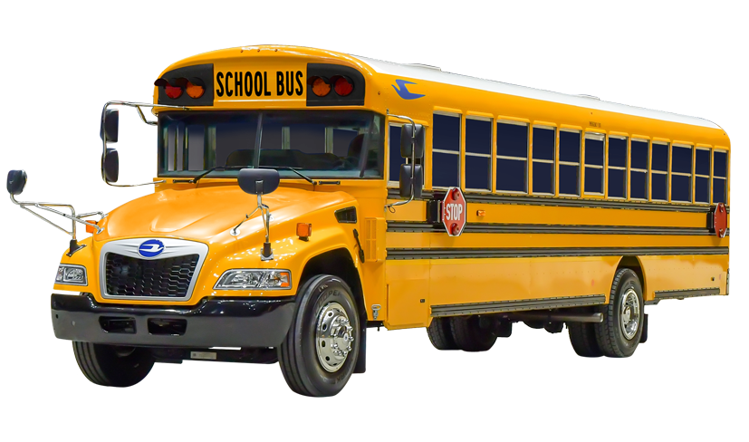
Transportation
HCY are eligible for transportation to the school of origin. 42 U.S.C. §11432(g)(1)(J)(iii)
Right to transportation extends
For the duration of the homelessness or
Until the end of the school year in which they obtain housing 42 U.S.C. §11432(g)(3)(A)(2)
Transportation should be comparable to what others receive 42 U.S.C. §11432(g)(4)(A)
LEAs are required to enroll homeless students immediately, and transportation must be arranged without delay

Slide 23
Transportation
Districts can split the cost & responsibility
Can use a common agreement
If can’t come to agreement, then the split is 50-50 42 U.S.C. §11432(g)(1)(J)(iii)
Can use the following to cover excess cost:
MV funds
Title I, Part A of the Elementary and Secondary Education Act funds 42 U.S.C. §11433(d)(5) and 20 U.S.C. § 6313(c)(3)(C)(ii)

Slide 24
Transportation
• The mode of transportation is based on the best interest of the student and in consultation with the parent/guardian
The LEA ultimately determines the mode of transportation, as long as it does not create a barrier to the student
• If transportation is a barrier to extracurricular activities, the LEA would be required to provide or arrange transportation to and from the activity

Slide 25
Look for Clues
A history of attending many schools and erratic attendance and tardiness
Inadequate or inappropriate clothing for the weather
Resistance to parting with personal items.
Families in shelters may move without notifying transportation
Homeless students move frequently, and bus routes change daily. Flexibility is essential.
It may be helpful to have the student sit near you on the bus.
Use patience with the students. They are meeting new challenges each day within their living situation and often feel they have no control over anything in their life.
If transporting homeless students from shelters and hotels, routes should be designed to pick them up first and drop off last to avoid embarrassment, harassment and bullying for other students.

Slide 26
Support and Report
Some GCS Supports:
Bookbags Hygiene Items Basic Clothing Gas Cards Food Cards Laundry Cards School Supplies Coats/Blankets Sleeping Bags Health Referrals Emergency Housing Tutoring Summer Camp – Freedom School College Tours Enrichment Activities Head Start Referrals Barbering Services Paint Therapy
You may be the first to learn that a student may be moving. If you are aware of this, please contact the district transportation department and the school social worker.

Slide 27
Services and Resources that are needed
Needs:
Extended days for emergency stay
Eviction Mediation
Third Meal Partners
Items that cannot be purchased with EBT cards
Medical and Dental Assistance
Mental Health Assistance
Employment
Housing and Housing Referrals
Housing Vouchers
Daycare Assistance

Slide 28
Questions

Slide 29
Contact Information
Drennan Rhyne Paylor
Coordinator of Homeless Services and Community Support
(O) 336-574-2637 (E) paylord2@gcsnc.com
Megan Griffin
Program Administrator
(O) 336-621-4042 (E) griffim5@gcsnc.com

