Slide 1
Envirothon School – Envirothon 101
Chelsea Sloggy, Conservation Education Specialist
Union County Soil and Water Conservation District

Slide 2
What is Envirothon?
Awesome!
“… a fun, hands-on, natural science academic event that engages and challenges students to think critically about the natural world and their role in it.”
Combines in-class studies with outdoor training to help students learn and experience the natural world, its processes, and related current issues

Slide 3
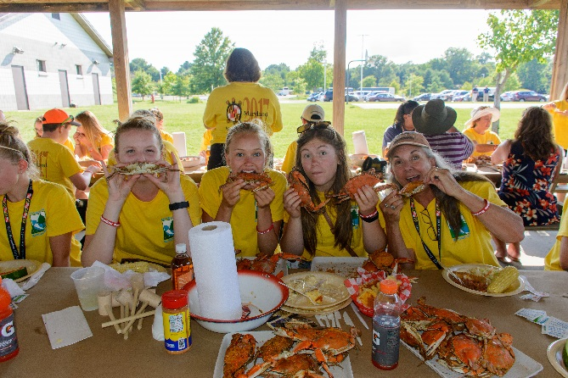
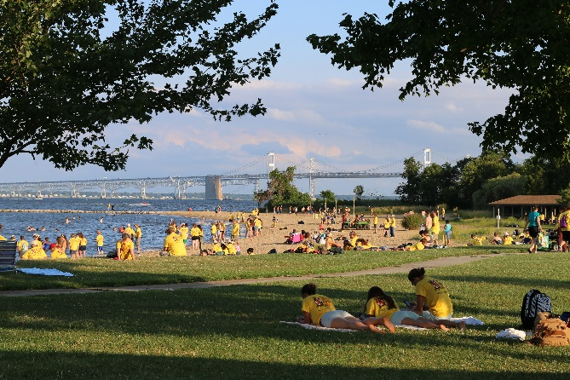
State and National Evirothon stats
NC Envirothon was found in 1990, over 25 years ago
Over 290 teams participate in NC each year
North America’s largest high school environmental education competition
Reaches more than 500,000 students each year
Over $100,000 in scholarships and prizes awarded each year
Participants come from the US, Canada, and China

Slide 4
Who organizes and supports Envirothon?

Slide 5
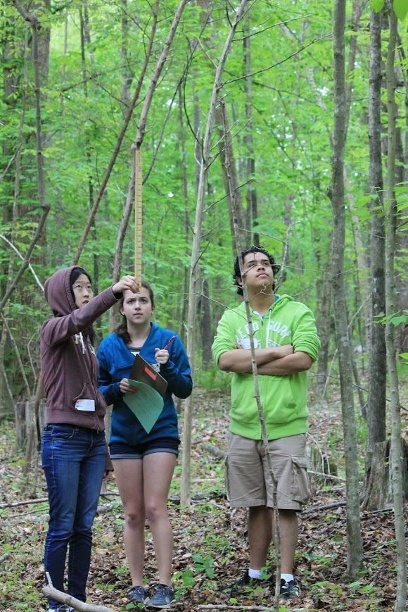
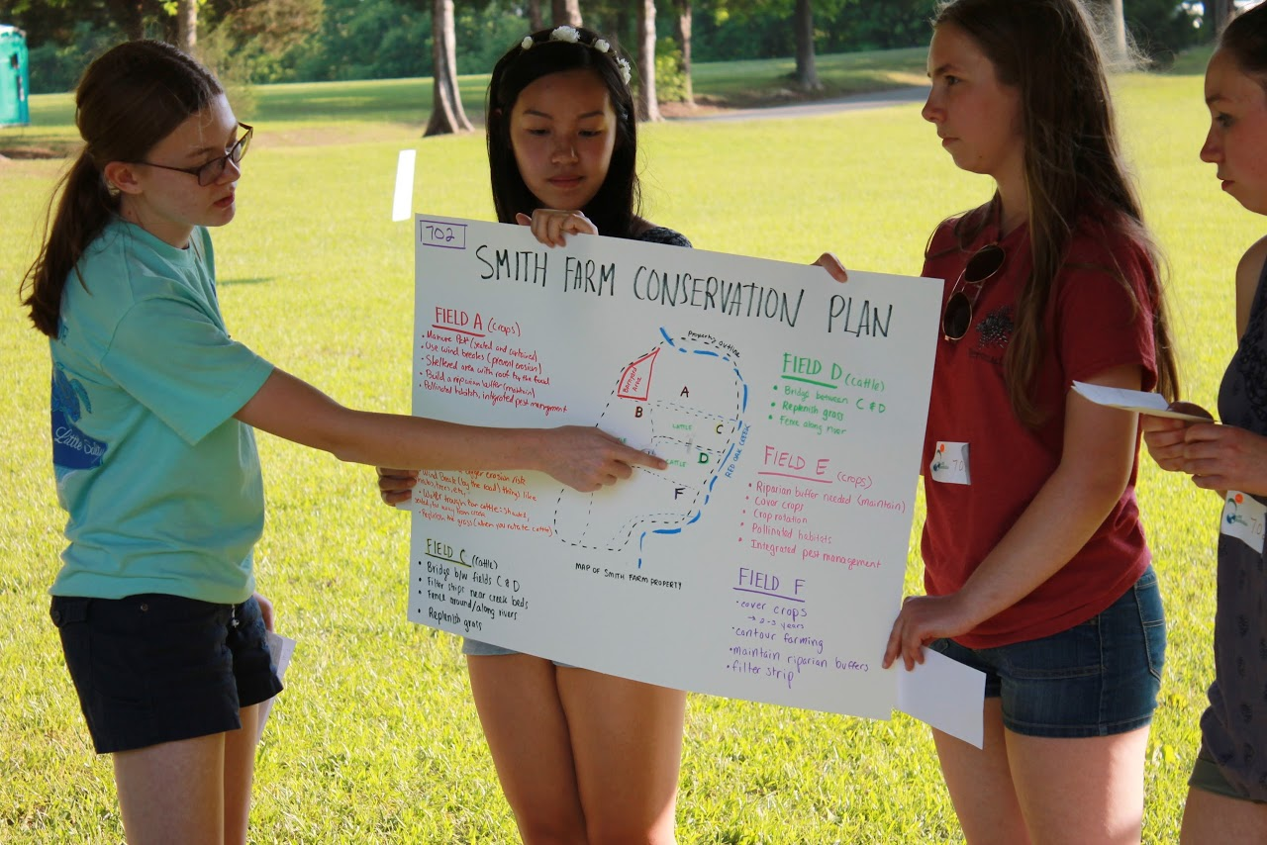
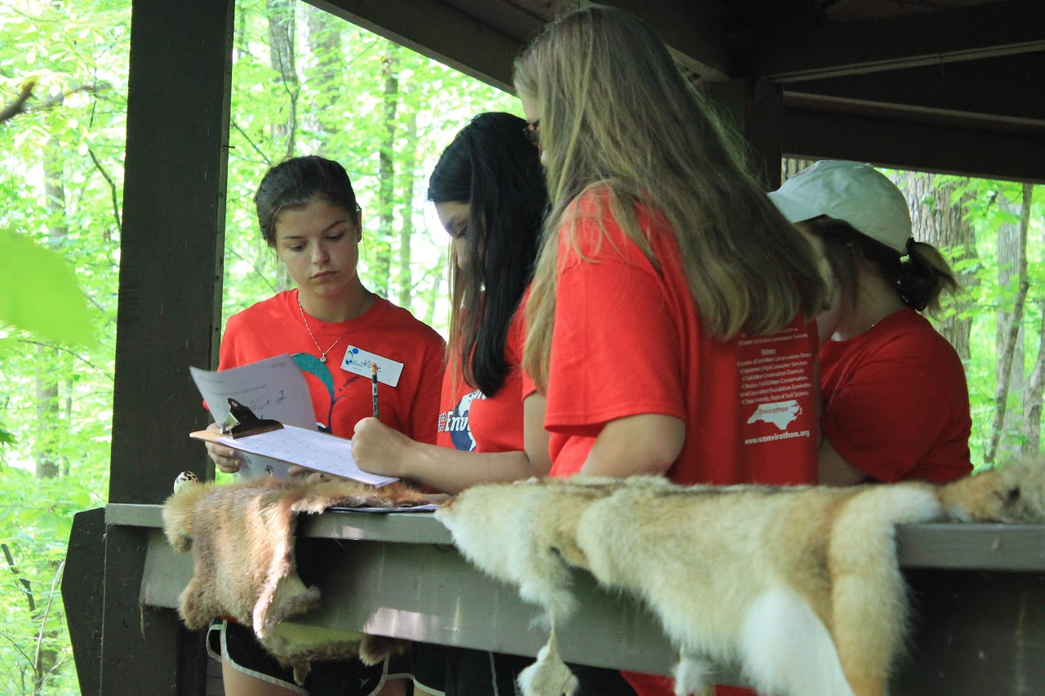
What are the Envirothon topics?
Soils and land use
Forestry and plant life
Wildlife and habitat
Aquatics and water quality
Current environmental issues
For high school teams only: Oral Presentation

Slide 6
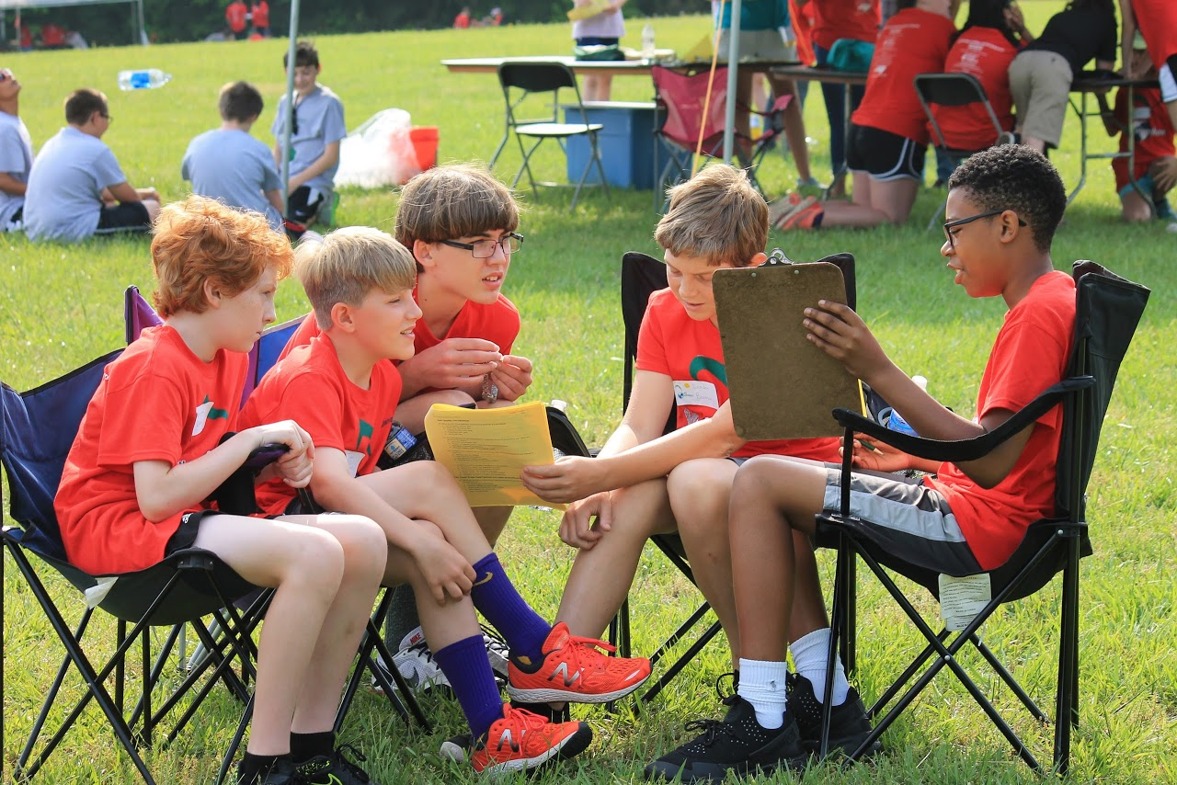
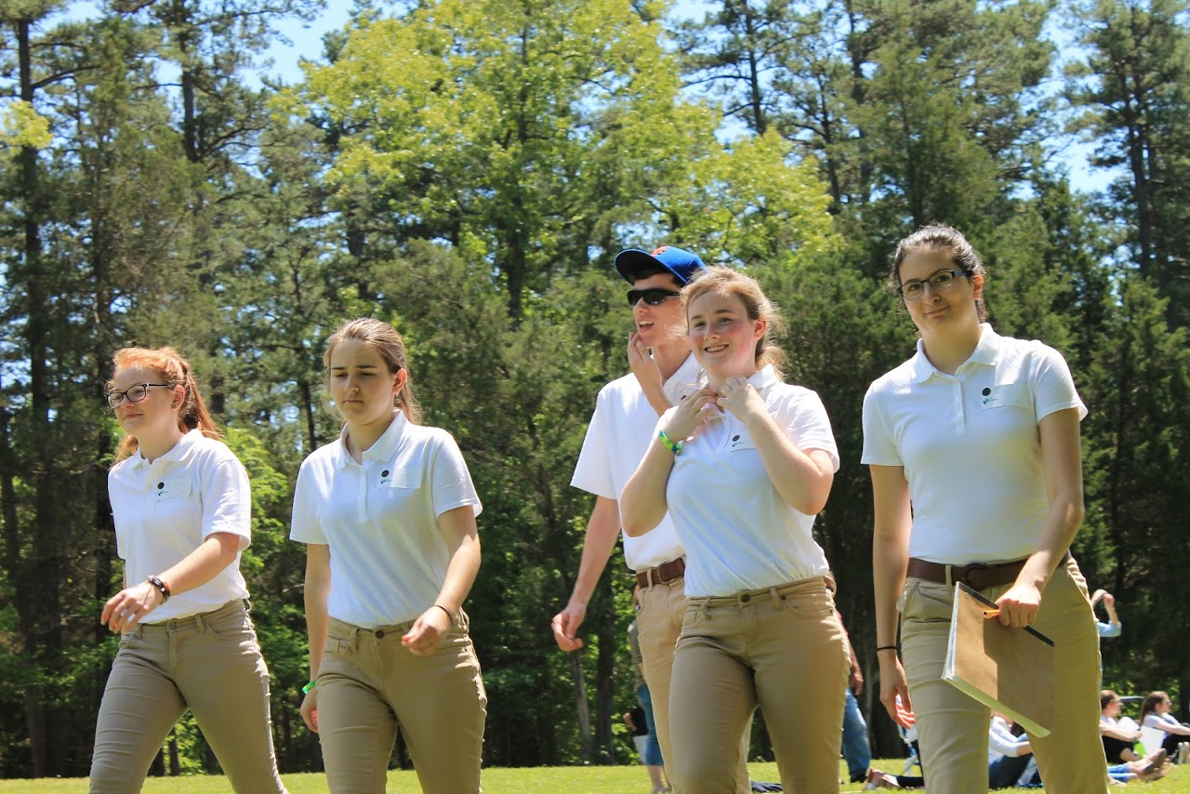
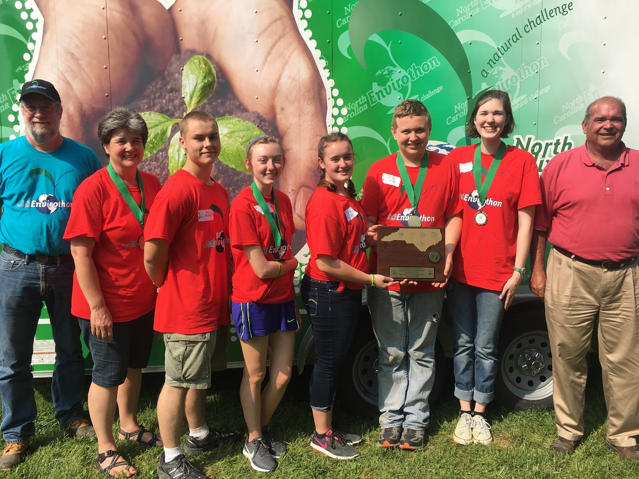
What do I need to form an Envirothon team?
3-5 students from the same middle/high school, non-traditional school, or youth organization such as 4-H, FFA, science, or Envirothon clubs.
Two optional alternates allowed – compete on mock alternate team
At least one volunteer advisor
An optional coach/resource provider (District employee)

Slide 7
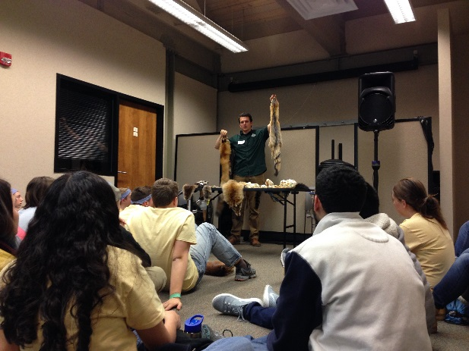
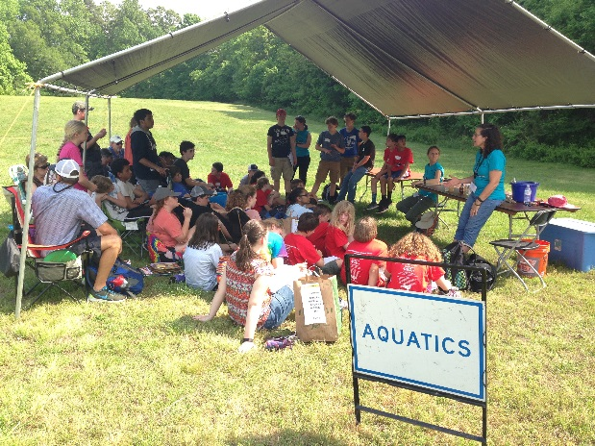
What does a year in Envirothon look like?
October-February: Topics training and team building
Meet as a team regularly to study materials
Field trip opportunities to gain field experience
Review sessions and mock competitions
March-April: Area Competition
April: State Competition
Two-day event
Cedarock Park, Burlington
5 highest scoring teams & 1 FFA team qualify
July: North American Envirothon

Slide 8
Roles: Advisor
Schedule meeting dates for your team(s)
Ensure students are studying materials
Secure resource professionals for enrichment
Schedule field trips at local field sites
Register team(s) for Area competitions
Many advisors will:
Create supplemental study materials for their students
Decide who will act as team members and who will act as alternates

Slide 9
Roles: Districts and District Employees
*Varies by District*
Provide supplemental study materials
Skulls, pelts, forestry tools, macroinvertebrate samples, soil samples, soil manuals, etc.
“Coach” teams
Share examples of Envirothon questions
Prepare high school teams for Oral Presentation
Disseminate information from Envirothon committees
Many Districts will:
Pay State competition registration
Cover costs of travel and lodging

Slide 10
Envirothon Study Materials
NC Envirothon Website: NCEnvirothon.org
NC Division of Soil and Water Website: ncagr.gov/SWC/educational/envirothon

Slide 11
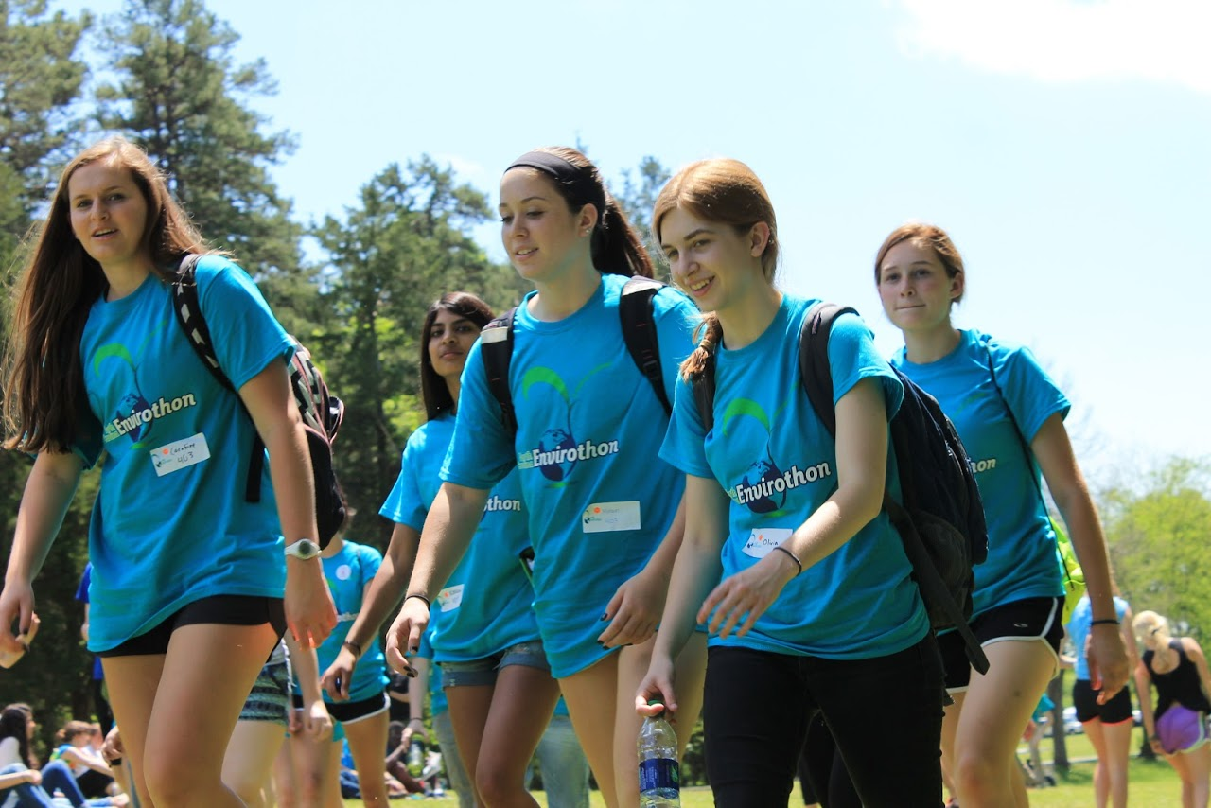
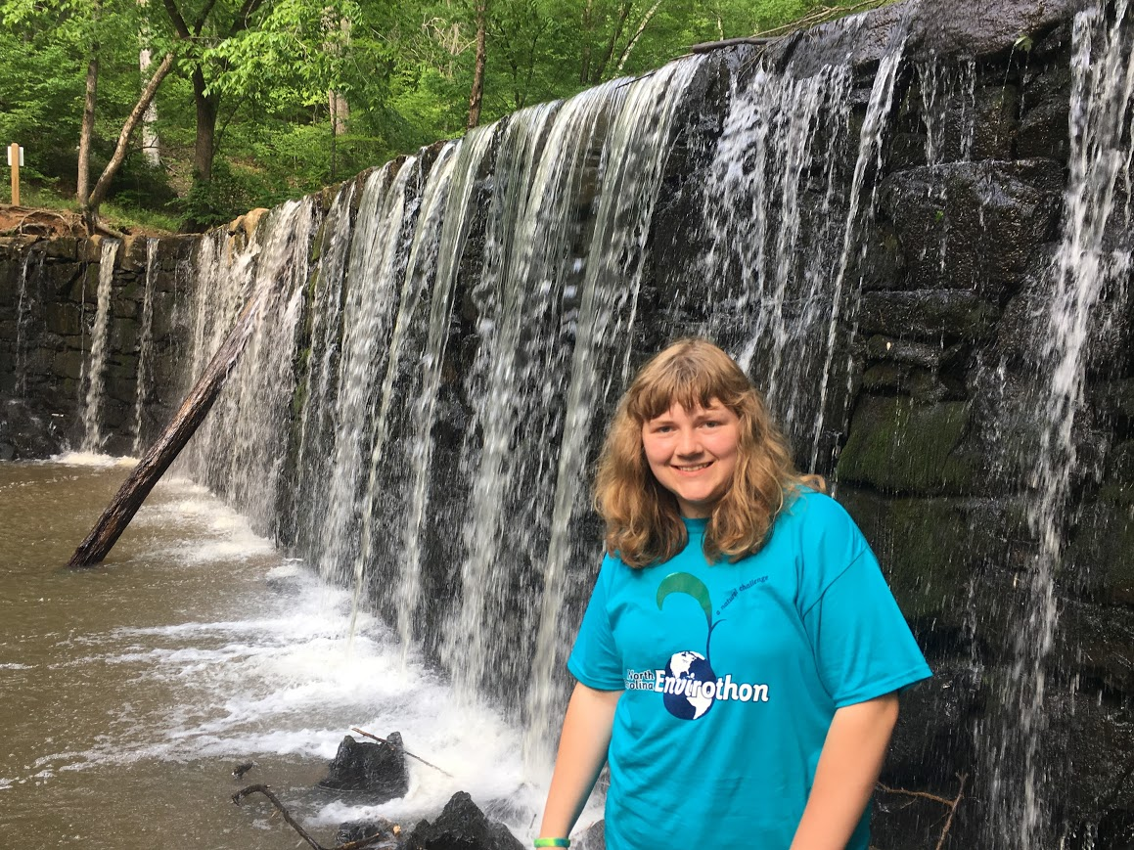
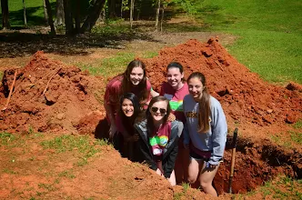
Why Envirothon?
Because it’s a blast!
Learn new and interesting material
Spend time in nature
Gain teamwork and leadership experience
Travel with your friends!
Professional development
Networking
Scholarships and cash prizes
College application building

Slide 12
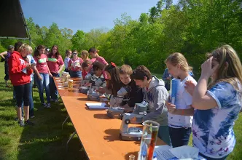
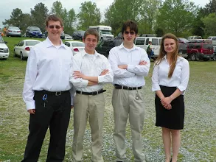
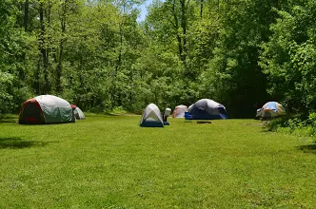
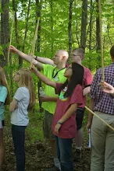
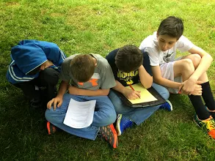
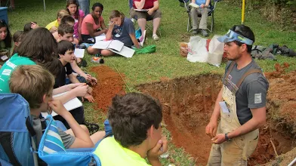
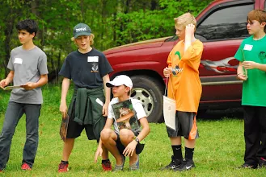
Questions and comments

