Slide 1
School Health
Guilford County DHHS
Public Health Division

Slide 2
The School Health Program supports Guilford County Schools through case management, health education and consultation in order to remove health related barriers to learning.

Slide 3
The American Academy of Pediatrics has a new policy statement published in the June 2016 issue of Pediatrics that calls for a minimum of one full-time registered nurse in every school.

Slide 4
School Year 2018-2019 GCS Student Population – 73,939 42 Nurses Served 123 Schools Each Nurse serves 3 – 4 Schools 1 Nurse : 1,737 Students School Nurse Contacts -210,861 School Visits – 3,982

Slide 5
The School Health Program Provides:
Chronic Disease Management
Training of school staff and monitoring of medical procedures
Medication administration training and monitoring
Immunization and Health Assessment follow-up
Screening, referrals, and follow-up for: vision, dental, and other health conditions

Slide 6
School Health Offers Many Other Services
Case Management of Chronic Conditions
Health Care Plans
Health Education Classes
Pregnancy Referral/Follow-Up/Counseling
Liaison between Home, School and Community Health Care Provider

Slide 7
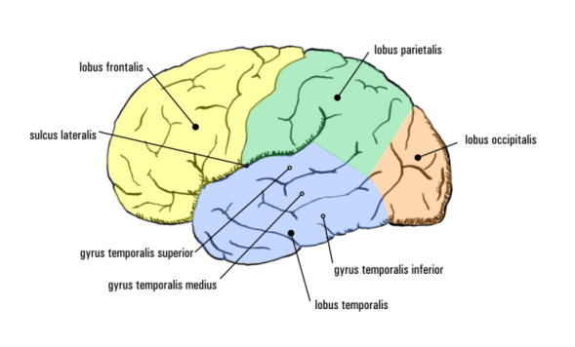
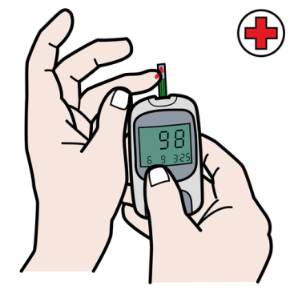
4 Most Common Chronic Diseases in the School Setting
Asthma
Severe Allergies
Seizures
Diabetes

Slide 8
19% of GCS Students Identified with a Chronic Health Condition in 2018-2019
Asthma - 6,448 students
Severe Allergies – 3,438 students
Seizure Disorder – 422 students
Type I Diabetes – 213 students

Slide 9
Chronic Disease Case Management Goals Include:
Reduced Symptoms
Improved Academic Success
Improved Self Care
Increased Teacher/Staff Education
Safer School Environment
Improved Family/Peer Relationships

Slide 10
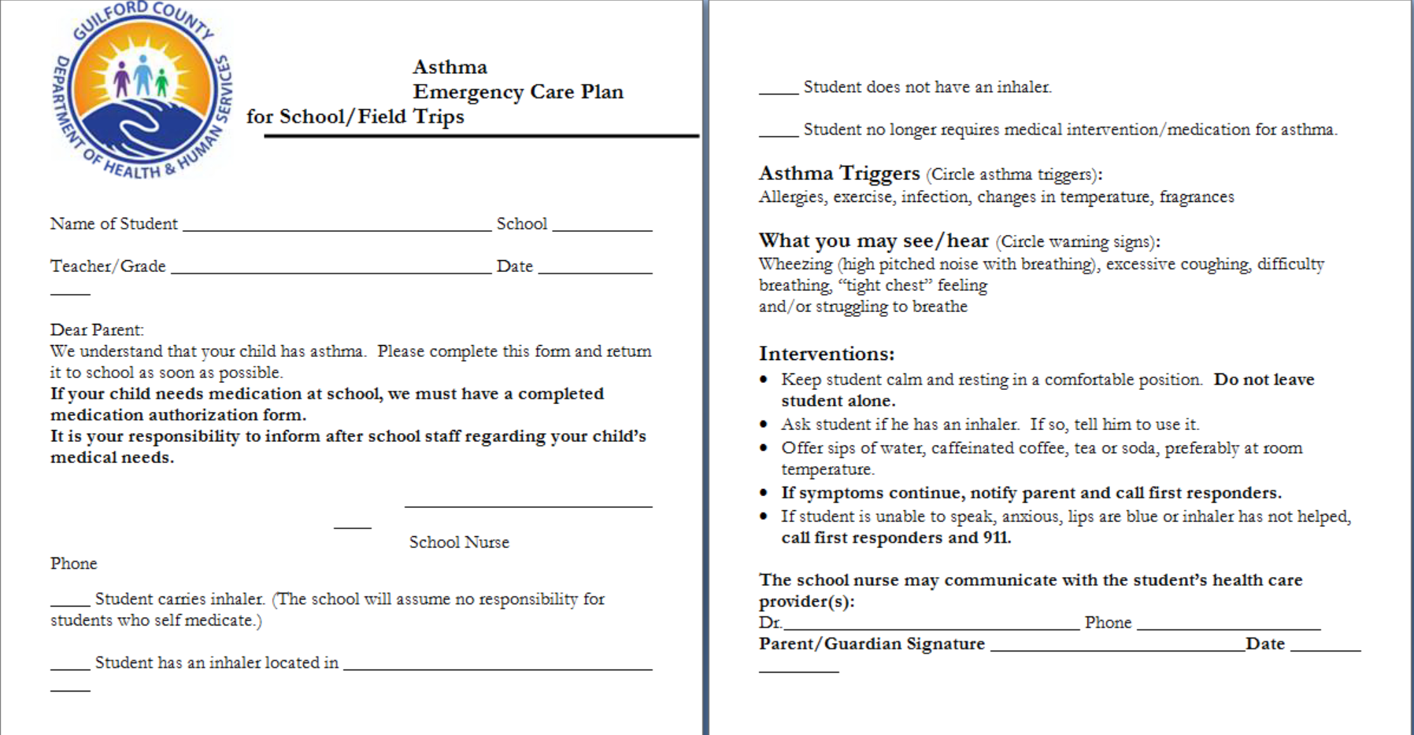

Slide 11
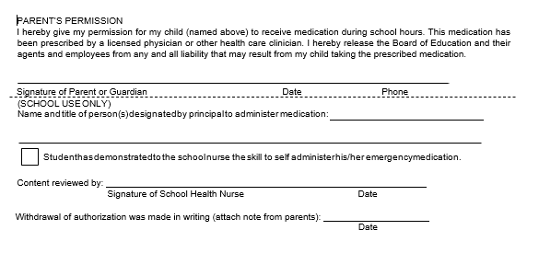

Slide 12
In 2018- 2019, numerous procedures were performed by school staff as trained by school nurses - for example, tube feedings and urinary catheterizations. We need health care provider orders to provide service in school.

Slide 13
Communicable Disease Surveillance
Work with Public Health Communicable Disease Program to control reportable diseases.
Provide surveillance when there is an outbreak to determine individuals in schools at risk of exposure.
Educate the school staff and families about disease prevention.

Slide 14
School Nurses in 2018 -2019 * Screened visions for 23,058 students * Referred 2,218 students to an eye care provider * Helped to secure resources for many families

Slide 15
What Else Do We Do?
We respond to the health of the community in Guilford County as DHHS Public Health Nurses.
We also assist with the immunization clinics, emergency shelters, and present at health fairs.

Slide 16
Advocates for Children
The School Nurses are continuously advocating for our students. A working partnership with all health providers in our community can make a difference in the lives of children and enhance their ability to become a healthy and successful adult.

Slide 17
School nurses collaborate with multiple community service providers including:
Children’s Mental Health Collaborative
YMCA Adolescent Program Advisory Board
Wrap Around for Triad Adult Pediatric Medicine
Cone Health Center for Children
Cone Health Family Medicine Center
Pediatric Team with Partnership for Community Care
Child Fatality Prevention Team
Guilford County Asthma Coalition

Slide 18
Healthy Children Learn Better
A student’s health status is directly related to his or her ability to learn. The school nurse supports the physical, mental, emotional, and social health of students and their success in the learning process.

Slide 19
How Can You Contact Us?
Susan Hawks, BSN, RN, NCSN
Lead School Nurse Supervisor
(336) 641-3896
shawks@guilfordcountync.gov
Janis Surratt – High Point Supervisor
Beth Jaekle – Greensboro Supervisor
Sharain Carter – Greensboro Supervisor

Slide 20
Resource Information
School Health Program
http://www.guilfordcountync.gov/our-county/human-services/health-department/school-health/

